Slide 1
SPONSORSHIP PROPOSAL

Slide 2
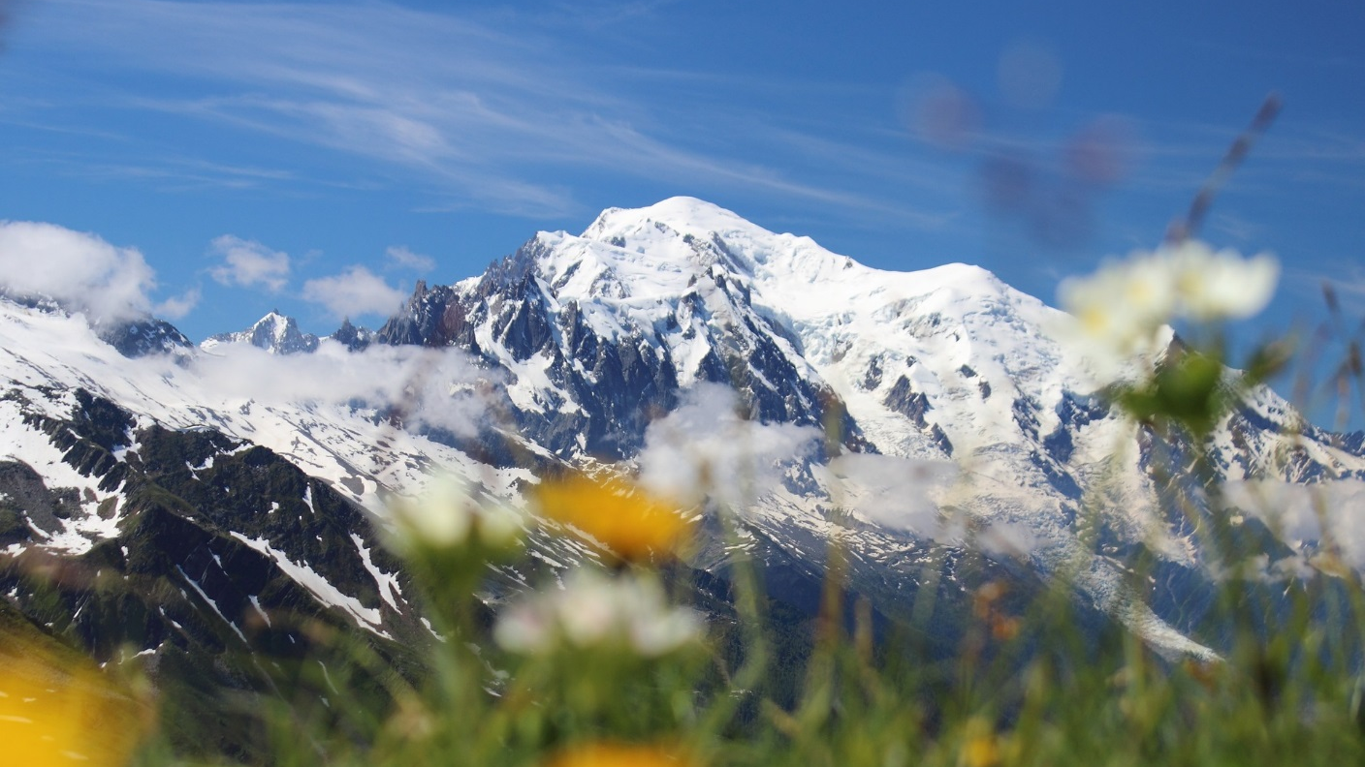
RAID IN FRANCE – 11th Edition
MONT BLANC – SAVOIE – 23 june to 2 july 2021
Team Name

Slide 3
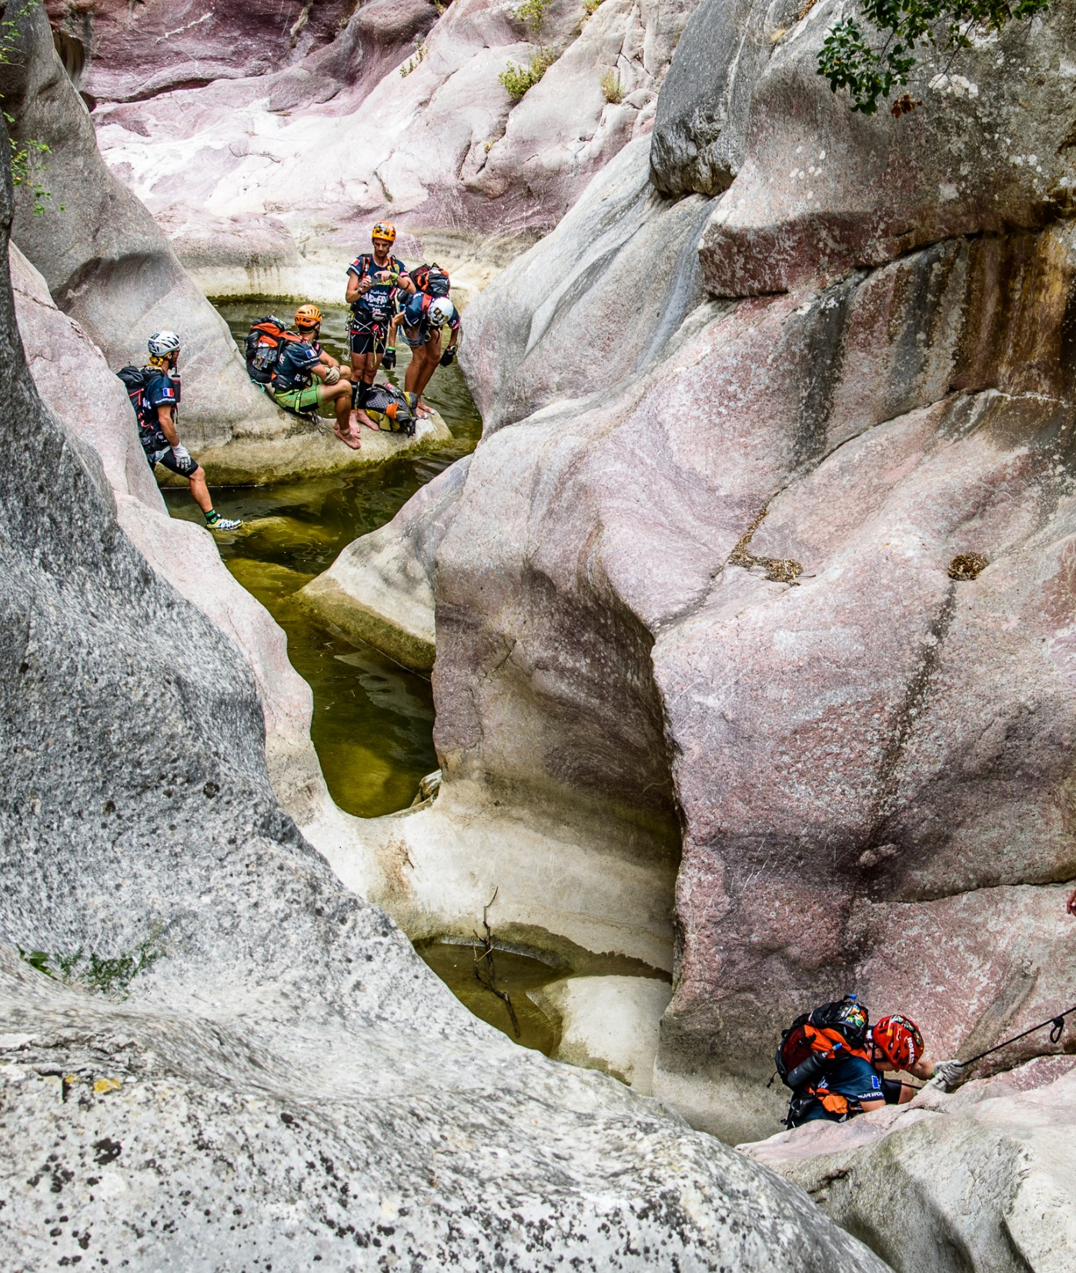
SUMMARY
1. OUR TEAM
2. THE EVENT
3. BACK TO THE 2018 EDITION
4. RAID IN FRANCE 2021
5. OUR SPONSORSHIP OFFER
«
An unforgettable memory, a wonderful and professional organising team [...] Raid in France never fails keeping up with our expectation ; it's an incredible support for promoting territories.
…
»
Christian FEROUSSIER, Vice-President for Sports of of the Ardèche Department (2017)

Slide 4
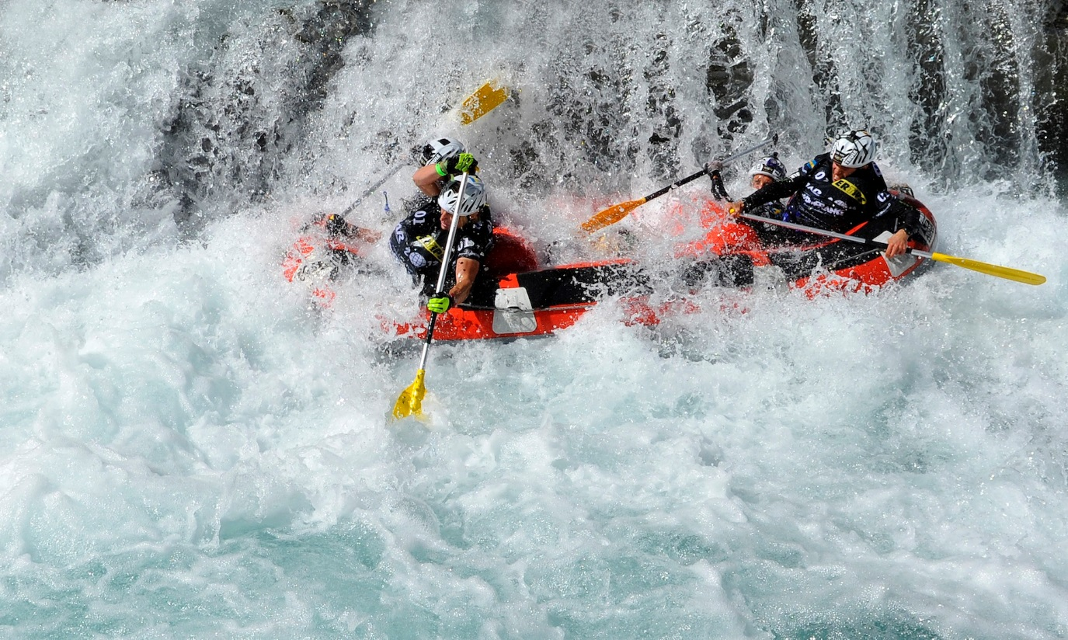
1. OUR TEAM
Team Name

Slide 5
Team Name
Our team in a few words…
jhslhmslmhsflmhfsmhsfmshmsfhsfmhfsmfhsmshsfmhsfoqhipdsjqipjudpqzudoziqo^ziqo^zidzo^qdiopqdci<jcpwxjcpodwco^jdojco^pjwpocjpwdfjpdojupdfsvjspjvps^jvd^sjdsqopjvdpsqvjspqvjspqdvjqsp^vjdojdqopjqpjpqjcpj.
klxhwoshwdxodshqnophnxipwhnipxhnipwhnidhviodhsiophvsbnhwduhiqudsqgzyzegfygzqhlwjkjlmwjùmwki.
Results
2018 : 1st ARWC Réunion
2017 : 2nd Ardèche Tour
…

Slide 6
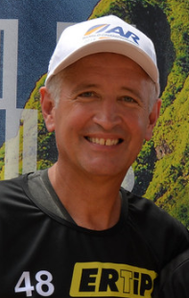
Motivation & goals
Team Name
Hgqslhqelqhjlùqjdqlhjdihvdhvnopqziopaeuu^pipjkqj,xwpj
More information
«
This race is unique. You don’t need to travel worldwide; everthing is here ! Each
edition is different and reveals it’s own discoveries, issues but joys. It’s hard to
describe, it’s must be experienced
…
»
Daniel MASSY, Team Belgium
10 éditions de Raid in France à son actif.

Slide 7
Team Name
Teammate 2
jhslhmslmhsflmhfsmhsfmshmsfhsfmhfsmfhsmshsfmhsfoqhipdsjqipjudpqzudoziqo^ziqo^
Teammate 3
jhslhmslmhsflmhfsmhsfmshmsfhsfmhfsmfhsmshsfmhsfoqhipdsjqipjudpqzudoziqo^ziqo^
Teammate 1
jhslhmslmhsflmhfsmhsfmshmsfhsfmhfsmfhsmshsfmhsfoqhipdsjqipjudpqzudoziqo^ziqo^
Teammate 4
jhslhmslmhsflmhfsmhsfmshmsfhsfmhfsmfhsmshsfmhsfoqhipdsjqipjudpqzudoziqo^ziqo^

Slide 8
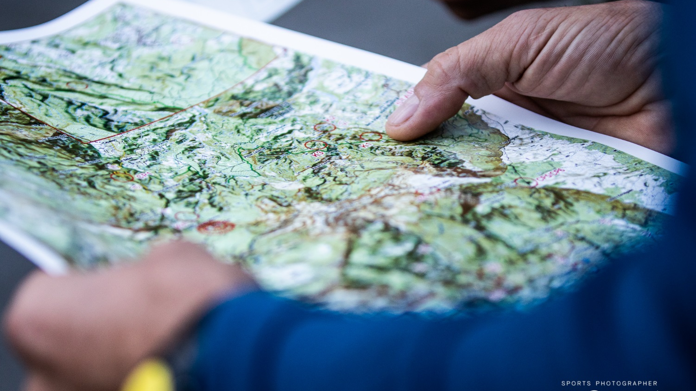
2. THE EVENT
RAID IN FRANCE

Slide 9
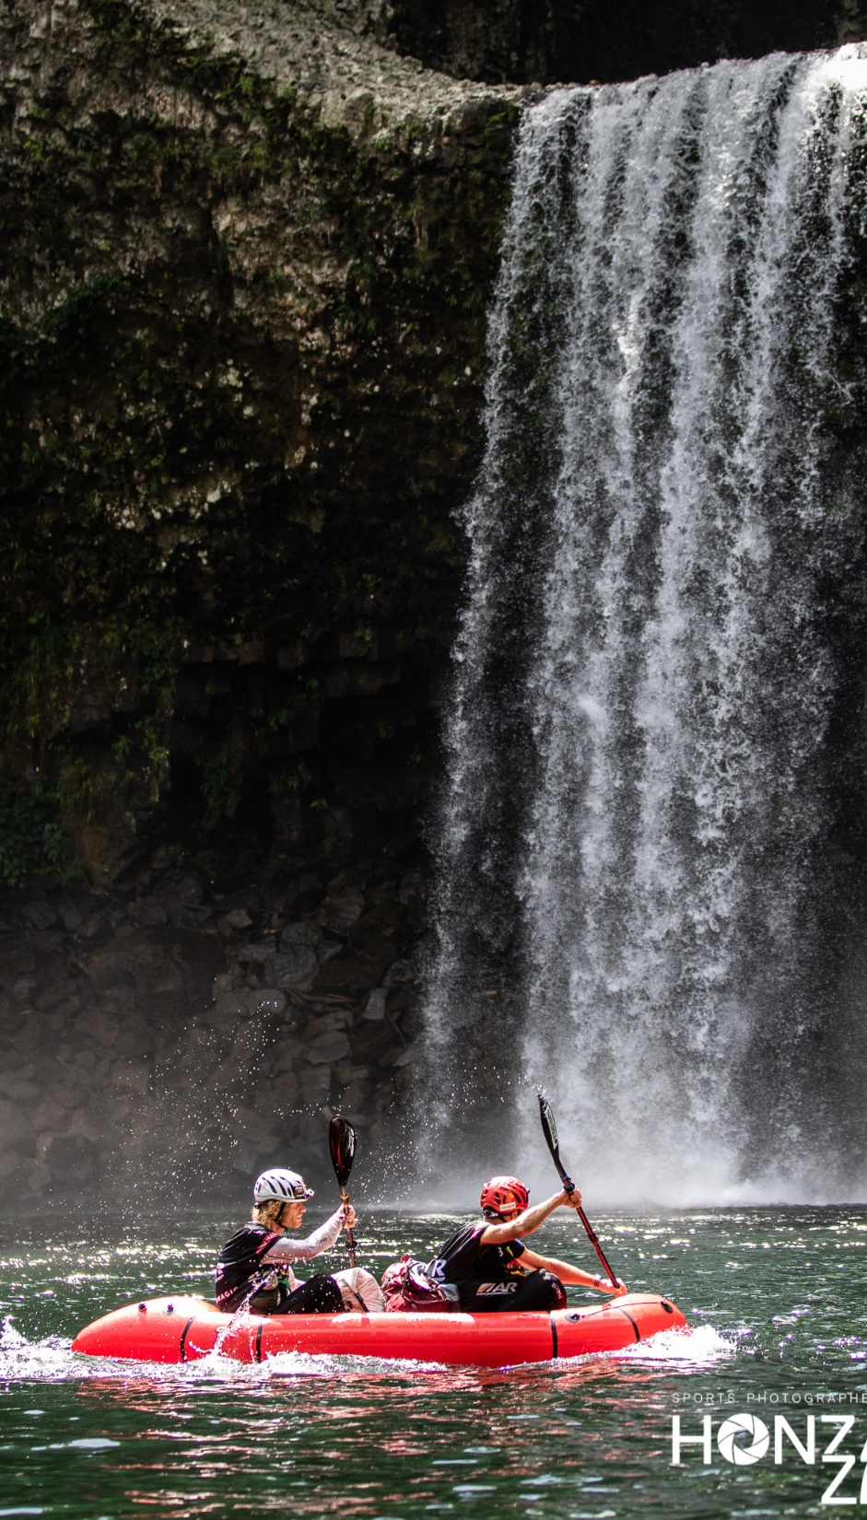
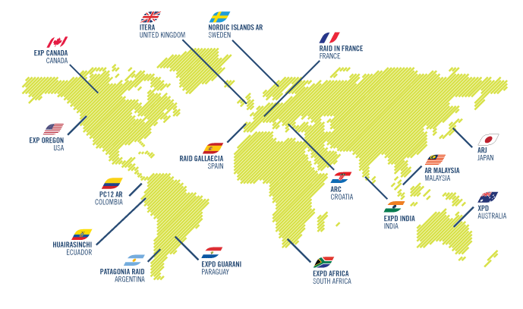
ARWS CIRCUIT
Adventure Racing World Series (ARWS) was created in 2001. It is the circuit that unites “long-distance” adventure racings around the globe. It organizes and structures the world cup.
There are 16 rounds all around the world : Spain, South Africa, USA, Australia, France, Ecuador, Canada, Malaya,Paraguay, Norway, Argentina, Japan, India, Croatia, United Kingdom, Colombia.
All these rounds are qualifier events in the Adventure Racing World Championship (ARWC).
In october 2021, Spain will host this Championship.

Slide 10
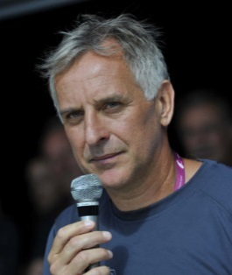
Adventure race on French and adjacent territory, each edition takes place in a different region in France
For the ARWS racing circuit, teams are made of 4 racers including at least one woman
The race lasts 5 to 8 days: approximately 500km in a nonstop progression (day and night), about 20.000 meters of uphill climb. GPS and any other artificial navigation system are strictly forbidden. An accounted total of 120 to 170hours of nonstop adventure racing.
Activities including mountain biking, trekking, white waters (canoe, kayak), canyoning, caving, mountain, ropes (abselling, vertical jumar climb, monkey bridge…), horse ridding, orienteering…
40 to 75 teams
Raid in France has settled as the leading adventure race in the French outdoor realm, a sport experiencing a sharp expansion with nearly 200 races organized throughout France, with more than 35.000 enthusiasts. No other race is remotely like it: an adventure race in total autonomy. The concept is simple: 4 racers (including at least one woman) completely immerged in the wilderness for a 5 to 8 days non-stop adventure. The route remains secret until the race starts. The itineraries are uncovered in real time by the participants during the race.
Having participated to the world’s biggest races, the organizers of Raid In France can bear witness to the diversity of French territory; with perfect settings for adventures as exotic as South America, Africa or Oceania.
Raid In France race adventure requires serious training. Routes and race layouts are known to be extremely demanding. Teams sign up for a minimum 96 hours of non-stop sports.
Raid in France was founded by Pascal Bahuaud, olympic rowing finaliste in 1988 at Séoul and 13 times french rowing champion, competed in 10 Raids Gauloises, finishing second 5 times and third twice.

Slide 11
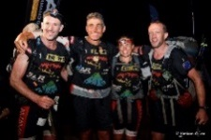
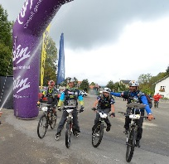
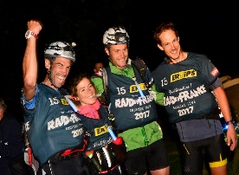
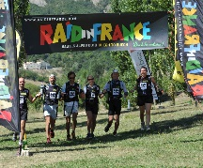
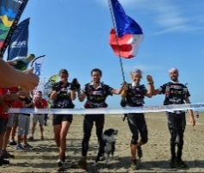
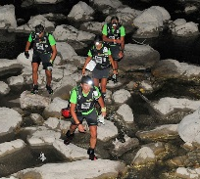
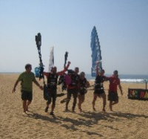
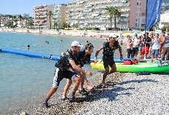
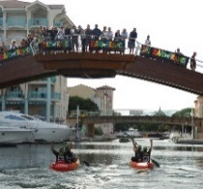
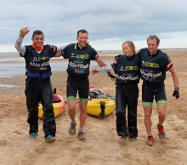
2015 – All Around Ain
The history
2017 – Ardèche Tour
2018 – La Réunion
World Championship
2010 – Buech to Buech
2018
2015
2011
2010
2014 – Volcanos to Camargue
2017
2014
2009
2012
2007
2011 – Les Baronnies Provençales
2016
2007 – Pyrénées
2016 – Pyrénées - Gulf
2012 – French Riviera
World Championship
2009 – Alps to Sea

Slide 12
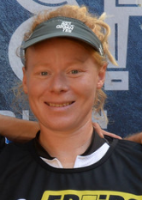
« BACK TO NATURE »
Back to nature, the slogan of Raid in France, carries organization's requirements in terms of environmental protection. Raid In France’s “back to nature” charter, is signed by all participants and members of the organization. This charter gives us the means for a complete immersion, controlled and respectful amidst the territories we go through.
OUR VALUES
Going back to a genuine “running”, simple and authentic: orientation without GPS, a limited number of checkpoints for more freedom in orientation choices and free-moving out of the signposted itinerary, forbidding any kind of movement assistance (sailing…), complete autonomy.
An immersion in Nature and its often-neglected natural and cultural resources: team will be given a « Memories and Territories » booklet that retracing great historical, human and environmental aspects of the territories that the race goes through.
Organization of the signature of the « Back to Nature » charter, by all members of the race (participants, staff, sponsors and the media) during the opening brief.
«
Any human being, who faces his own physical limits in a natural environment
Will experience how goodwill to his team mates and trusting others is the strongest
Drive to overcome any issue. Measuring ourselves as a team to nature’s strenghts,
Trying to live in this environment , appreciating it’s hidden beauties, and
Always finding solutions to keep going; is an extraordinary challenge.
…
»
Stéphanie Blockx, Team ADEORUN

Slide 13
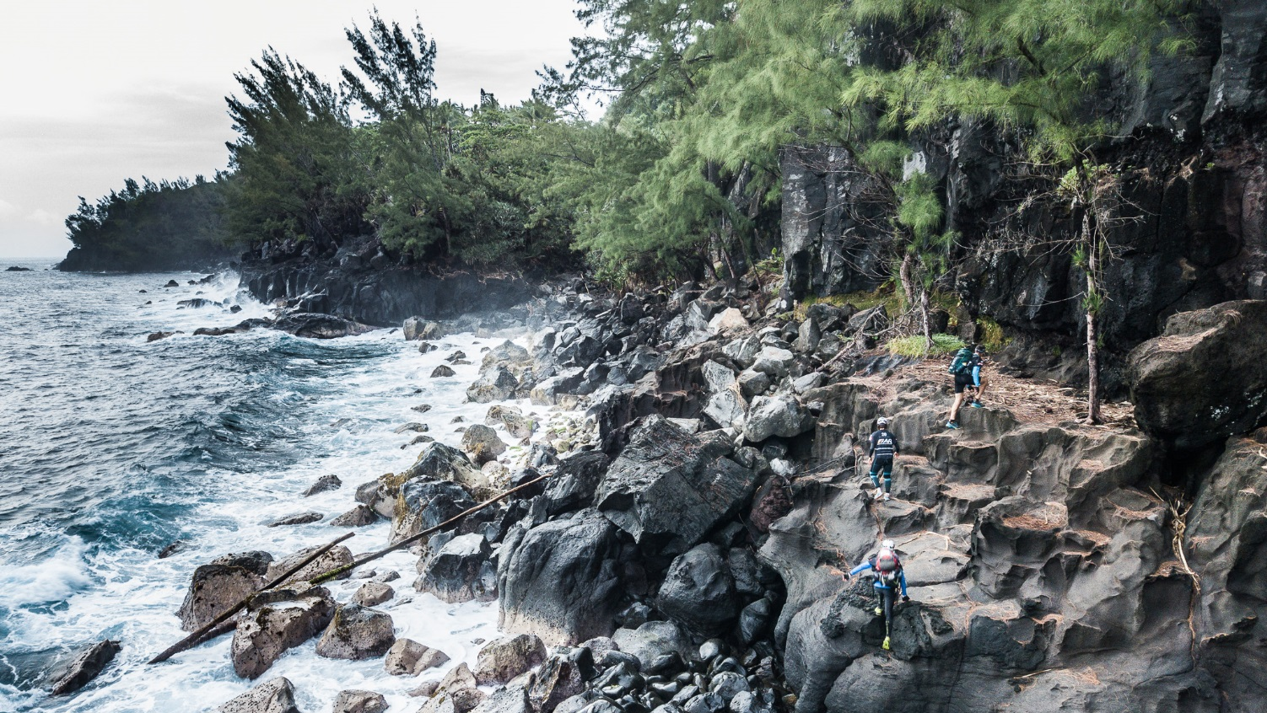
3. BACK TO THE 2018 EDITION
ADVENTURE RACING WORLD CHAMPIONSHIP 2018 – LA REUNION

Slide 14
BACK TO THE 2018 EDITION
Location – La Réunion
(November 2018)
AVAYA
(117 heures)
AGLOFS SILVA
(120h and 47min.)
400 TEAM NATUREX
(120h and 49min.)
Total distance
425,5 km
Disciplines
trek, MTB, packraft, kayak,
canyoning, caving, ropes
Time
117 h (4,9 days) for the winners (Avaya/NZ) to 8,3 days for the last team
Teams
59 Teams on the start line,
25 nationalities
«
…
»
Raid in France is a fantastic race. It’s always very demanding, technically and
Physically. Pascal Bahuaud is, for sure, one of the best ARWS race designers
Team AVAYA (2018 World Champion)

Slide 15
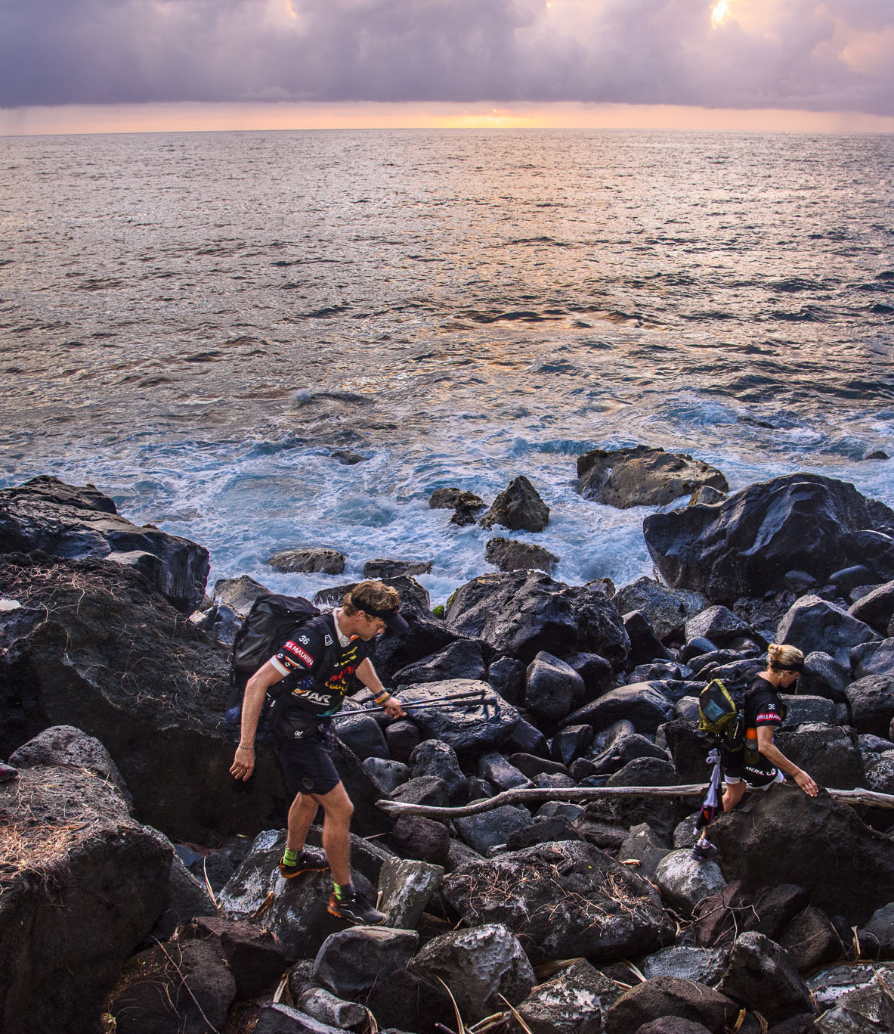
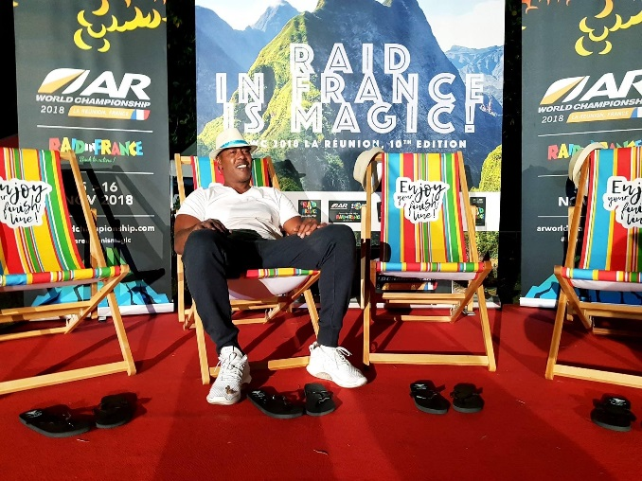
BACK TO THE 2018 EDITION
Digital audience :
150,000 unique visitors to live site and official corporate sites over the 8 days of the race - 1 200 000 seen pages - 59 million people reached, more than 100 follower sites (referencing the ARWS),
450 000 videos viewed (all official platforms) and 23 000 Instagram stories viewed.
55 journalists, photographers, cameramen and accredited directors
(12 nationalities)
More than 150 press articles
«
…
End of Raid in France ! What a beautiful memories and a great experience.
They are all crazy ! Thank you all for this adventure !!!
»
Jackson RICHARDSON, parrain de l’ARWC 2018 – La Réunion
Audience TV
Over 3 hours of live reporting (or daily deferred) accumulated
on national and foreign channels during the 8 days of the race
Over 15 hours of broadcasting of the official 52-minute film on 3 TV channels in December 2018 and January-February 2019

Slide 16
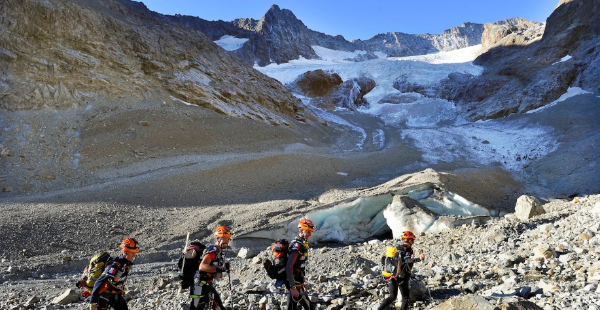
4. RAID IN FRANCE 2021
MONT-BLANC - SAVOIE

Slide 17
BOURG SAINT MAURICE 06/21/2021
AIX LES BAINS
07/02/2021
Time
96 to 144 hours
Disciplines
high mountain, trek, MTB,
packraft, kayak,
canyoning, caving, ropes
65 teams
20 nationalities
Total distance
More than 400 km
Elevation
+ 15 000 m accumulated
55
120
205
255
375
0
+ 400 km

Slide 18
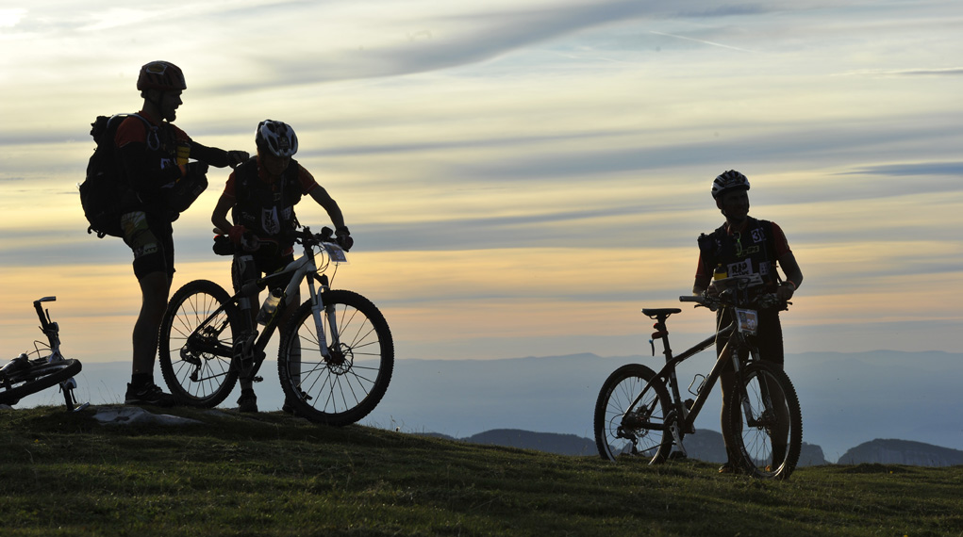
4. OUR SPONSORSHIP OFFER
NOM EQUIPE

Slide 19
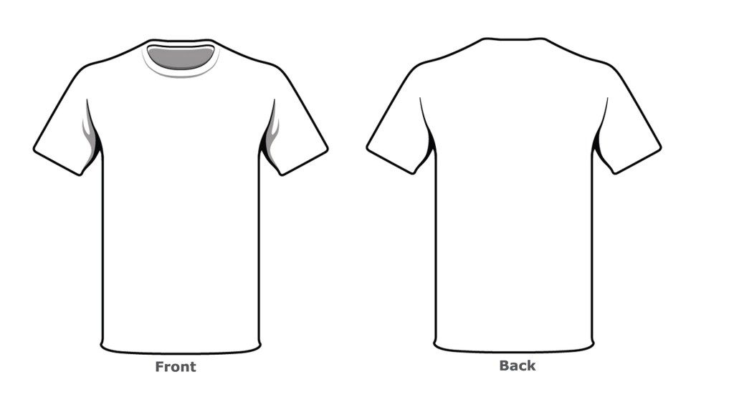
OUR SPONSORSHIP OFFER
TEXTILE
your explanations and prices here…
Jlkshusomhipj^ùmjk^ùmoqkzo^kioejiehnfuioehnvsiphjnsiphjniô^xiiieeee
Jlkshusomhipj^ùmjk^ùmoqkzo^kioejiehnfuioehnvsiphjnsiphjniô^xiiieee
Jlkshusomhipj^ùmjk^ùmoqkzo^kioejiehnfuioehnvsiphjnsiphjniô^xiiieee
Jlkshusomhipj^ùmjk^ùmoqkzo^kioejiehnfuioehnvsiphjnsiphjniô^xiiieee
Jlkshusomhipj^ùmjk^ùmoqkzo^kioejiehnfuioehnvsiphjnsiphjniô^xiiieee
other explanations here …
Jlkshusomhipj^ùmjk^ùmoqkzo^kioejiehnfuioehnvsiphjnsiphjniô^xiiieeee
Jlkshusomhipj^ùmjk^ùmoqkzo^kioejiehnfuioehnvsiphjnsiphjniô^xiiieee
Jlkshusomhipj^ùmjk^ùmoqkzo^kioejiehnfuioehnvsiphjnsiphjniô^xiiieee
Jlkshusomhipj^ùmjk^ùmoqkzo^kioejiehnfuioehnvsiphjnsiphjniô^xiiieee
Jlkshusomhipj^ùmjk^ùmoqkzo^kioejiehnfuioehnvsiphjnsiphjniô^xiiieee

Slide 20
OUR SPONSORSHIP OFFER
DIGITAL
your explanations and prices here…
Jlkshusomhipj^ùmjk^ùmoqkzo^kioejiehnfuioehnvsiphjnsiphjniô^xiiieeee Jlkshusomhipj^ùmjk^ùmoqkzo^kioejiehnfuioehnvsiphjnsiphjniô^xiiieee
Jlkshusomhipj^ùmjk^ùmoqkzo^kioejiehnfuioehnvsiphjnsiphjniô^xiiieee
Jlkshusomhipj^ùmjk^ùmoqkzo^kioejiehnfuioehnvsiphjnsiphjniô^xiiieee
Jlkshusomhipj^ùmjk^ùmoqkzo^kioejiehnfuioehnvsiphjnsiphjniô^xiiieee
OTHER
your explanations and prices here…
Jlkshusomhipj^ùmjk^ùmoqkzo^kioejiehnfuioehnvsiphjnsiphjniô^xiiieeee
Jlkshusomhipj^ùmjk^ùmoqkzo^kioejiehnfuioehnvsiphjnsiphjniô^xiiieee
Jlkshusomhipj^ùmjk^ùmoqkzo^kioejiehnfuioehnvsiphjnsiphjniô^xiiieee
Jlkshusomhipj^ùmjk^ùmoqkzo^kioejiehnfuioehnvsiphjnsiphjniô^xiiieee
Jlkshusomhipj^ùmjk^ùmoqkzo^kioejiehnfuioehnvsiphjnsiphjniô^xiiieee

Slide 21
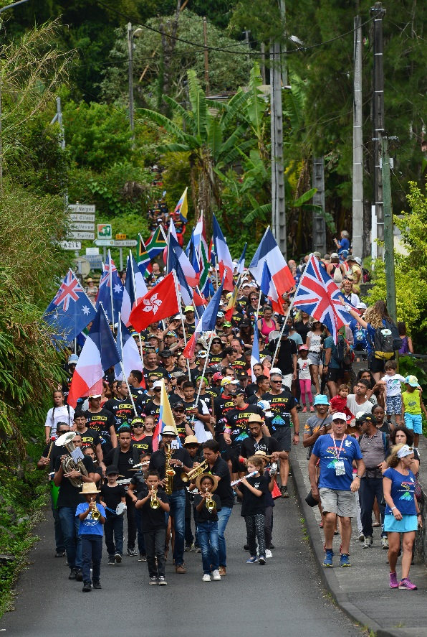
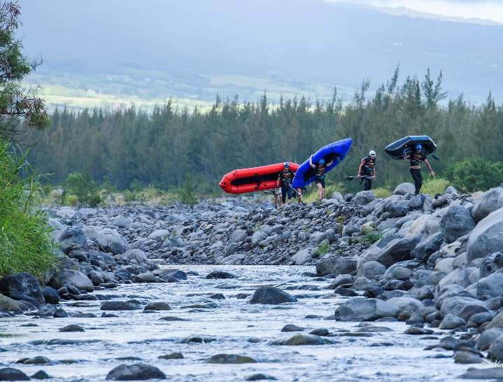
Budget
registration cost
000 €
accommodation
000 €
transport
000 €
material purchase
000 €
other
000 €
other
000 €
other
000 €
other
000 €
other
000 €
other
000 €
other
000 €
other
000 €
total: 00000 €

Slide 22
Contact :
Name
mail address
Phone
Team website
info www.raidinfrance.fr or
raidinfranceofficial
RaidInFrance
RaidInFrance
raidinfrance

